Slide 1

Capstone Project
Real time fire and smoke detection using Deep learning using transfer learning
Team no. 2
MLA0403 – Deep Learning
Guided By Students Name
Dr.A.M.Arul Raj Sham S.-192325076 Professor Aravind kumar V.-192325148
Institute of Saveetha Hemanth-192325088
SIMATS Engineering Harsha Vardhan-192325115
Notes:
1
1

Slide 2
Abstract
Transfer Learning model
CNN feature extraction
Image classification
Video stream analysis
High detection accuracy
Reduced response time
Fire & smoke detection
Real-time monitoring
Early warning system
Deep Learning approach

Slide 3
AIM AND OBJECTIVE
Aim
Real-time fire detection
Real-time smoke detection
Early warning generation
Transfer Learning approach
Camera-based visual monitoring
Objectives
Fire and smoke dataset preparation
Image preprocessing
Data augmentation
Model training and fine-tuning
Performance evaluation

Slide 4
Introduction
Increasing fire accidents
Property damage
Human life risk
Delay in manual detection
AI-based monitoring
Automatic recognition
CCTV surveillance
Smart emergency response
Real-time prediction
Continuous monitoring

Slide 5
Litrature Survey
S.No | Year | Author | Journal | Methodology | Algorithm
1 | 2023 | Muhammad et al. | IEEE | Image Classification | ResNet50
2 | 2022 | Li et al. | Elsevier | Transfer Learning | MobileNetV2
3 | 2021 | Zhang et al. | Springer | CNN | VGG16
4 | 2024 | Kumar et al. | IEEE Access | Object Detection | YOLOv8
5 | 2023 | Chen et al. | Sensors | Deep Learning | EfficientNet

Slide 6
Problem Statement
Delayed fire detection
Human monitoring dependency
False alarms
Limited detection accuracy
Poor smoke recognition
High property loss
Safety challenges
Need for automated monitoring

Slide 7
EXISTING SYSTEM
Limitations
Sensor placement dependency
Limited visual information
Hardware dependency
Maintenance requirements
False alarms
No learned visual representation
Existing Methods
Smoke detectors
Heat detectors
Flame sensors
Manual CCTV monitoring
Threshold-based alarm systems

Slide 8
Input
CCTV surveillance cameras
Public fire datasets (Kaggle, Roboflow)
Industrial monitoring cameras
Forest surveillance cameras
Building security cameras

Slide 9
OutCome
Fire Detected → Red bounding box + Alert
Smoke Detected → Yellow bounding box + Alert
No Fire/Smoke → Normal monitoring
Confidence Score → e.g., Fire: 98.6%
Emergency Notification → Alarm/SMS/Email

Slide 10
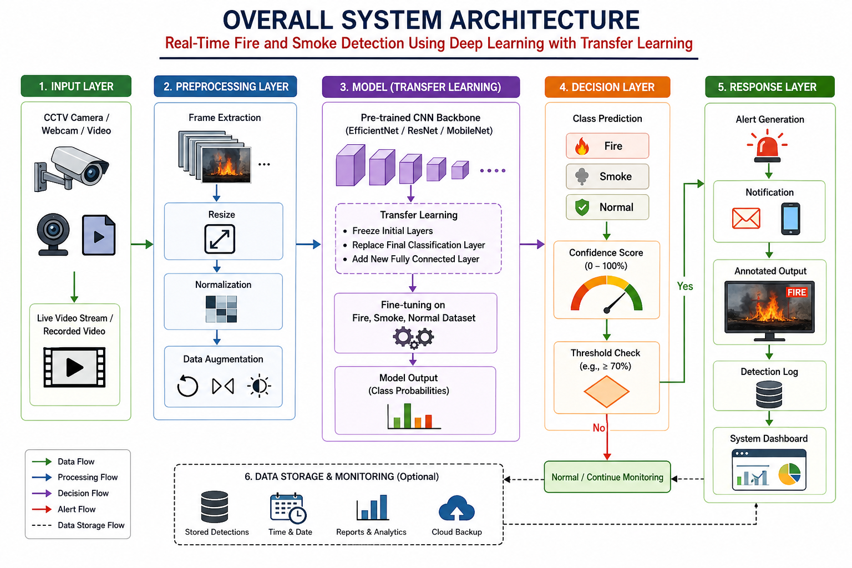

Slide 11


Sustainable Development Goal (SDG) Implementation
1. SDG 11 – Sustainable Cities and Communities (Primary SDG)
Goal: Make cities and human settlements safe, resilient, and sustainable.
2. SDG 9 – Industry, Innovation and Infrastructure
Goal: Build resilient infrastructure, promote sustainable industrialization, and foster innovation.
3. SDG 13 – Climate Action
Goal: Take urgent action to combat climate change and its impacts.

Slide 12
PROPOSED METHODOLOGY AND ALGORITHM
↓
Transfer Learning
↓
Fine-tuning
↓
Testing
↓
Real-Time Detection
Dataset
↓
Preprocessing
↓
Augmentation
↓
Pre-trained CNN

Slide 13
MODULE 1: DATASET COLLECTION & PREPARATION
Development Activities
Fire image collection
Smoke image collection
Normal image collection
Dataset cleaning
Duplicate removal
Class labelling
Dataset organization
Train / validation / test split
Class balancing
Expected Output
Clean dataset
Labelled images
Balanced classes
Structured dataset
Training-ready data

Slide 14
MODULE 2: IMAGE PREPROCESSING & AUGMENTATION
Development Activities
Frame extraction
Image resizing
Pixel normalization
Noise handling
Image quality checking
Rotation
Horizontal flipping
Cropping
Brightness variation
Scaling
Expected Output
Preprocessed images
Augmented samples
Consistent input size
Improved model generalization

Slide 15
MODULE 3: TRANSFER LEARNING MODEL DEVELOPMENT
Development Activities
Pre-trained model selection
CNN backbone initialization
Feature extraction
Classification head replacement
Fire / Smoke / Normal classes
Initial layer freezing
Model training
Layer unfreezing
Expected Output
Trained Deep Learning model
Class probabilities
Validation metrics
Saved model weights

Slide 16
MODULE 4: REAL-TIME FIRE & SMOKE DETECTION
Development Activities
Webcam integration
CCTV integration
Live video stream
Frame-by-frame processing
Real-time inference
Fire prediction
Smoke prediction
Normal prediction
Annotated video output
Expected Output
Fire label
Smoke label
Normal label
Confidence score
Live detection display

Slide 17
MODULE 5: ALERT SYSTEM & PERFORMANCE EVALUATION
Development Activities
Alert trigger
Alarm activation
Notification generation
Detection history
Accuracy calculation
Precision calculation
Recall calculation
F1-score calculation
Confusion matrix
Expected Output
Warning message
Alert notification
Detection history
Performance report
Model evaluation
Deployment readiness

Slide 18
Conclusion
Problem → Delayed fire/smoke detection
Solution → Transfer Learning-based deep learning model
Impact → Faster response, improved safety, reduced damage
Project Value → Intelligent, scalable, and practical fire detection system.

Slide 19
References
K. He, X. Zhang, S. Ren, and J. Sun, "Deep Residual Learning for Image Recognition," Proceedings of the IEEE Conference on Computer Vision and Pattern Recognition (CVPR), 2016.
M. Tan and Q. Le, "EfficientNet: Rethinking Model Scaling for Convolutional Neural Networks," Proceedings of the International Conference on Machine Learning (ICML), 2019.
A. Howard et al., "Searching for MobileNetV3," Proceedings of the IEEE International Conference on Computer Vision (ICCV), 2019.

